Slide 1

Introduction to Game Theory
Chris Kiekintveld

Slide 2
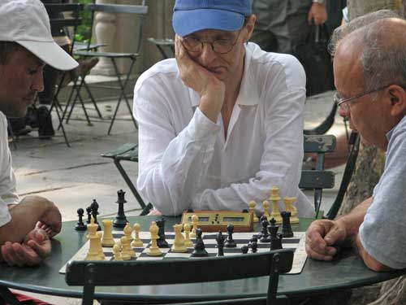
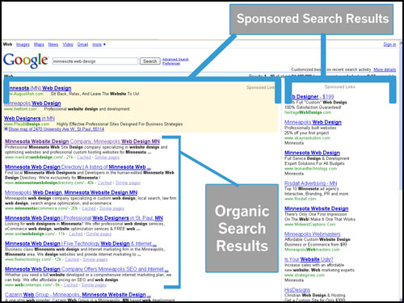
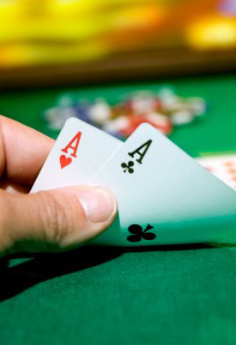
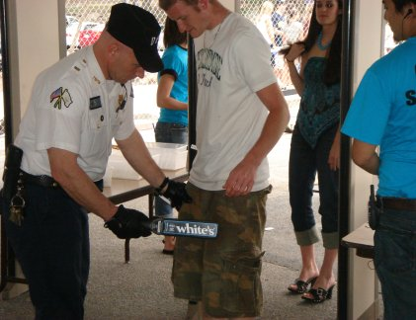
Examples of Games
Chess
Backgammon
Poker
Auctions
Sponsored search
Security
Network protocols
Video games
Financial markets
…

Slide 3
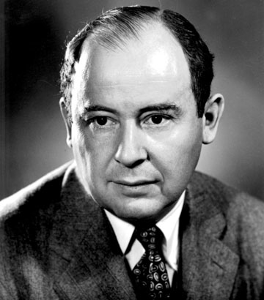
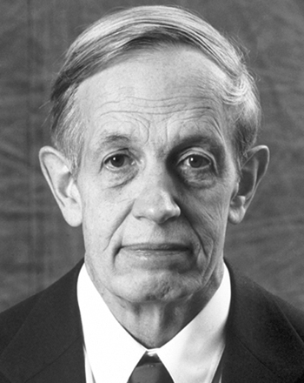
Computational Game Theory
Mathematical framework
for multi-agent decisions
Economics, business, political science, biology,
computer science, psychology, law, urban planning…

Slide 4
Cooperative vs. Non-Cooperative Game Theory
“Cooperative” games
Assume players can form coalitions and transfer utility among coalition members (i.e., payments)
Focus on which coalitions (groups) will form and are stable (no one wants to change groups)

Slide 5
Cooperative vs. Non-Cooperative Game Theory
“Non-Cooperative” games
Focus on the strategies of individual players (i.e., what actions each player should choose
Coalitions do not explicitly coordinate
May form implicitly, but cannot make “side payments”
Can include both adversarial and cooperative situations
Looks for stable solutions where all players are playing rationally and finding “good” actions

Slide 6
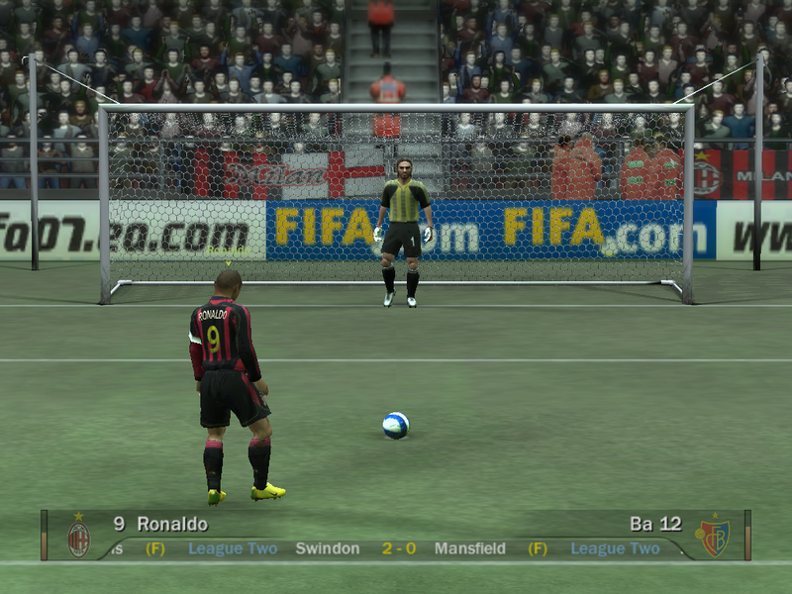
Example: Penalty Kicks

Slide 7
Questions about Games
How should we formalize the interaction?
How much do players know?
Do they all know they are playing the same game?
Is it one-time or repeated?
What do players know about each other?
Are they rational?
Can they communicate?
How should we analyze a game?
What strategies should players use?
Can we predict what all of the players will do?
Can we design games to meet certain goals?
How sensitive are the solutions to assumptions?

Slide 8
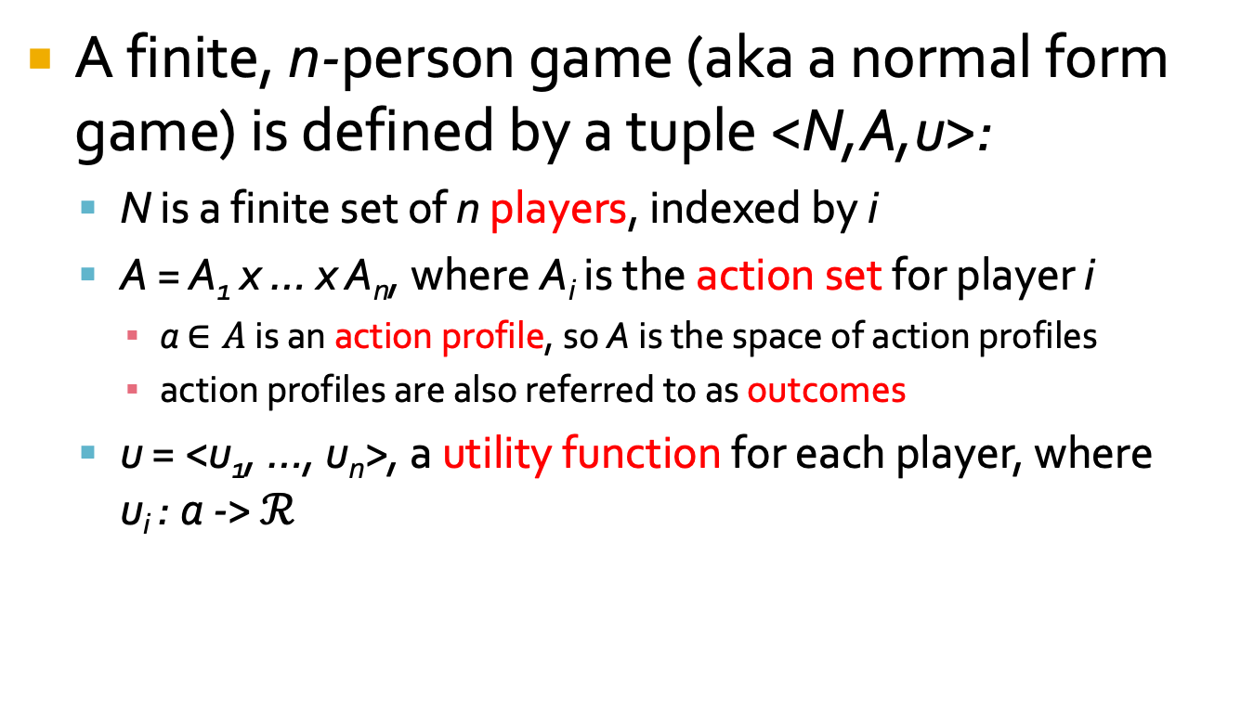
Defining Normal Form Games
A finite, n-person game (aka a normal form game) is defined by a tuple <N,A,u>:
N is a finite set of n players, indexed by i
A = A₁ x … x A_{n}, where A_{i} is the action set for player i
a $∈A$ is an action profile, so A is the space of action profiles
action profiles are also referred to as outcomes
u = <u₁, …, u_{n}>, a utility function for each player, where u_{i} : a -> $ℛ$

Slide 9
Basic Assumptions
Common knowledge: all players know the game they are playing, and know that other players also know it
Single shot: players will play the game exactly once
Simultaneous: players choose actions simultaneously without any communication or knowledge of the other player’s choice
Players are rational and self-interested (i.e., they only try to maximize their own utility
Note that we will relax most of these later on

Slide 10
Penalty Kicks (aka Matching Pennies)
Keeper
 | Left | Right
Left | -1, 1 | 1, -1
Right | 1, -1 | -1, 1
Kicker

Slide 11
Generalized Matching Pennies
0, 0 | 1, -1 | -1, 1
-1, 1 | 0, 0 | 1, -1
1, -1 | -1, 1 | 0, 0

Slide 12
Generalized Matching Pennies
Rock
Scissors
Paper
0, 0 | 1, -1 | -1, 1
-1, 1 | 0, 0 | 1, -1
1, -1 | -1, 1 | 0, 0
Rock
Scissors
Paper

